Slide 1
ADA Compliant Figure Making
Data Science Project Work Team (2023)
Daniel Ellis, Senior ES (Specialist) IEP Synthesis

Slide 2
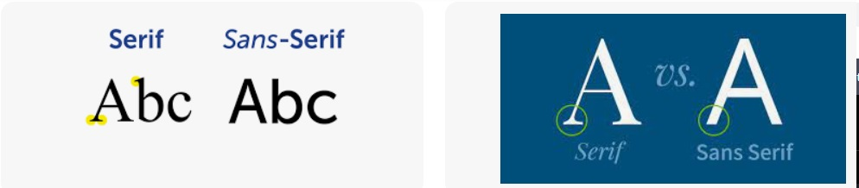
What is ADA compliance?
State Laws
Government Code §11546.7 – The requirement that state agency heads certify, every two years, that their agency’s website meets the Web Content Accessibility Guidelines, Version 2.0 or a subsequent version, at Level AA or higher, and the requirements of Sections 11135 and 7405 of the Government Code. Created by AB 434 (Baker, Chapter 780, Statutes of 2017), and sometimes referred to as AB 434.
Government Code §11135 – Requires that state programs and activities meet the requirements of Section 202 of the Americans with Disabilities Act (42 U.S.C. §12132), federal regulations implementing the ADA, and any state laws that provide stronger protections.
Government Code §7405 – Requires that state governmental entities’ websites (and other electronic and information technology systems) comply with the accessibility requirements of Section 508 of the Rehabilitation Act of 1973, as amended (29 U.S.C. §794d) and implementing regulations.
Federal Laws and Regulations
Section 508 of the Rehabilitation Act of 1073 – The main federal law governing accessibility of federal electronic and information technology systems, which has been made applicable to California state government. The link goes to a federal web page that links to both the code section and its implementing regulations.
Aids those with serious or partial visual impairments
Font Style and Size
Sans serif font is preferred for accessibility
Size 12 points or larger for printed documents
Size 24 points or larger for PowerPoint presentations
Appropriate Use of Color
Never use color alone to convey information
Text and background color has a sufficient high level of contrast
Want these resources?
CA Government Page-
https://www.dgs.ca.gov/Resources/Statewide-Forms/ADAComplianceToolkit

Slide 3
What does the law say?
State Laws
Government Code §11546.7 – The requirement that state agency heads certify, every two years, that their agency’s website meets the Web Content Accessibility Guidelines, Version 2.0 or a subsequent version, at Level AA or higher, and the requirements of Sections 11135 and 7405 of the Government Code. Created by AB 434 (Baker, Chapter 780, Statutes of 2017), and sometimes referred to as AB 434.
Government Code §11135 – Requires that state programs and activities meet the requirements of Section 202 of the Americans with Disabilities Act (42 U.S.C. §12132), federal regulations implementing the ADA, and any state laws that provide stronger protections.
Government Code §7405 – Requires that state governmental entities’ websites (and other electronic and information technology systems) comply with the accessibility requirements of Section 508 of the Rehabilitation Act of 1973, as amended (29 U.S.C. §794d) and implementing regulations.
Federal Laws and Regulations
Section 508 of the Rehabilitation Act of 1073 – The main federal law governing accessibility of federal electronic and information technology systems, which has been made applicable to California state government. The link goes to a federal web page that links to both the code section and its implementing regulations.

Slide 4
When is it required?
State Laws
Government Code §11546.7 – The requirement that state agency heads certify, every two years, that their agency’s website meets the Web Content Accessibility Guidelines, Version 2.0 or a subsequent version, at Level AA or higher, and the requirements of Sections 11135 and 7405 of the Government Code. Created by AB 434 (Baker, Chapter 780, Statutes of 2017), and sometimes referred to as AB 434.
Government Code §11135 – Requires that state programs and activities meet the requirements of Section 202 of the Americans with Disabilities Act (42 U.S.C. §12132), federal regulations implementing the ADA, and any state laws that provide stronger protections.
Government Code §7405 – Requires that state governmental entities’ websites (and other electronic and information technology systems) comply with the accessibility requirements of Section 508 of the Rehabilitation Act of 1973, as amended (29 U.S.C. §794d) and implementing regulations.
Federal Laws and Regulations
Section 508 of the Rehabilitation Act of 1073 – The main federal law governing accessibility of federal electronic and information technology systems, which has been made applicable to California state government. The link goes to a federal web page that links to both the code section and its implementing regulations.
What’s that you say?
My technical document is getting published on our website?!
What’s that you say?
My technical document is getting published on our website?!
Notes:
You may think the project doesn’t need it, but best practice is to do it- you don’t know when it might be put online.

Slide 5
Principles of ADA-compliance
Font style and size
Use of color
Alternative text
Table header rows
Meaningful hyperlinks
Using built-in styles / designs (Microsoft Word)
Accessibility Testing

Slide 6
Principles of ADA-compliance
Font style and size
Use of color
Alternative text
Table header rows
Meaningful hyperlinks
Using built-in styles / designs (Microsoft Word)
Accessibility Testing

Slide 7
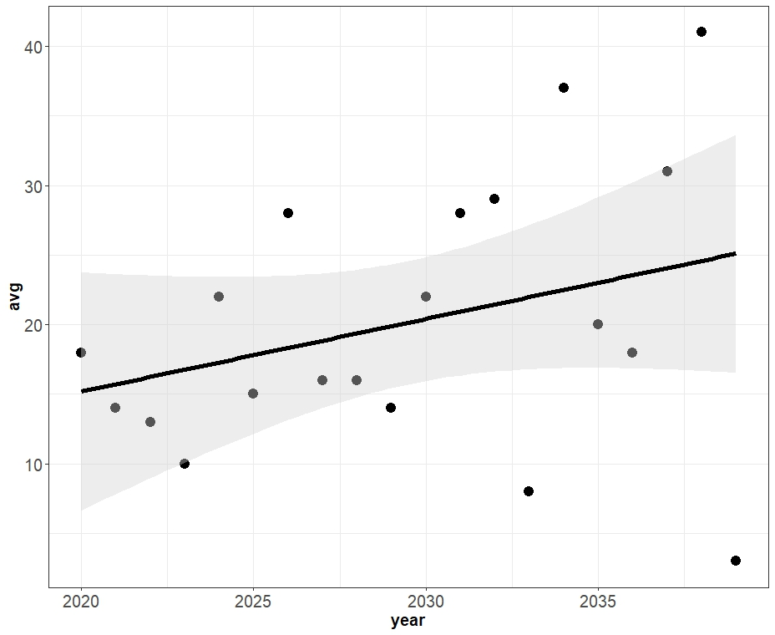
Scatterplots
Notes:
Fine, contrast is ok

Slide 8
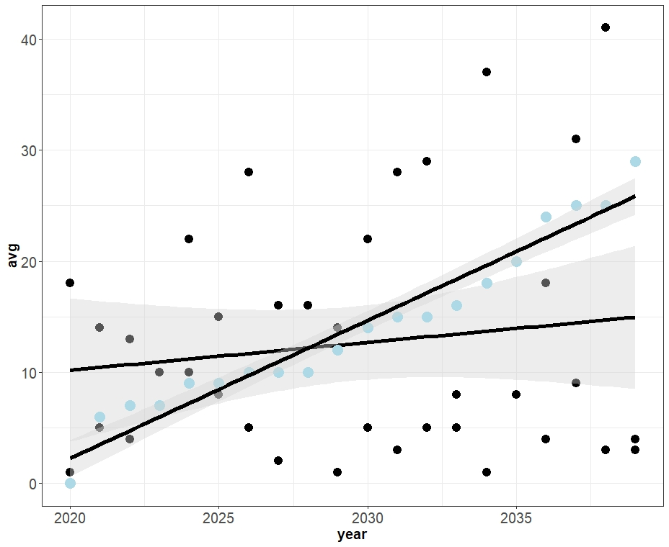
Scatterplots
Notes:
But what if we add a second line?
Issues with:
CI’s – CI’s
Points – CI’s

Slide 9
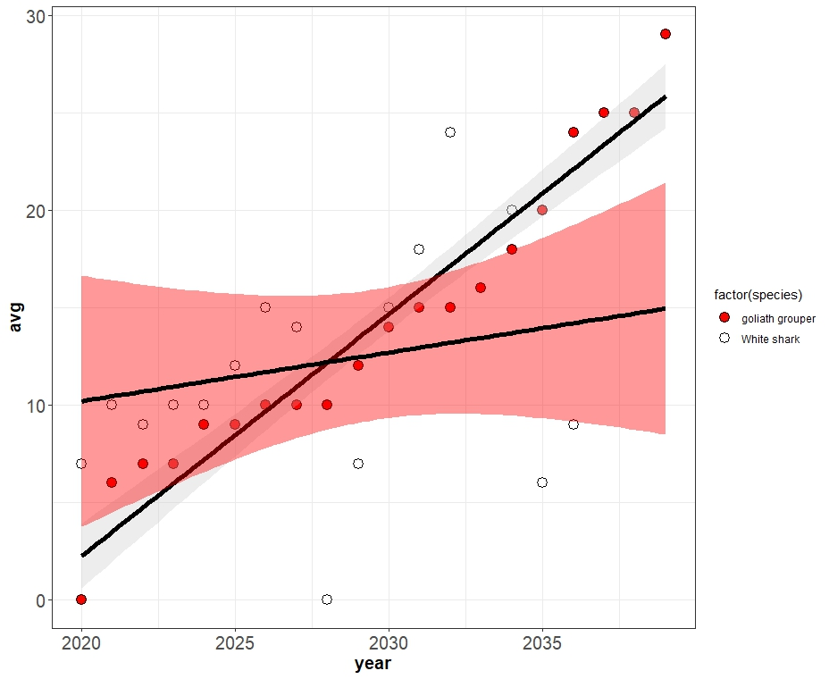
Scatterplots
Notes:
Better:
Outlined points
Different fill
Cis different colors

Slide 10
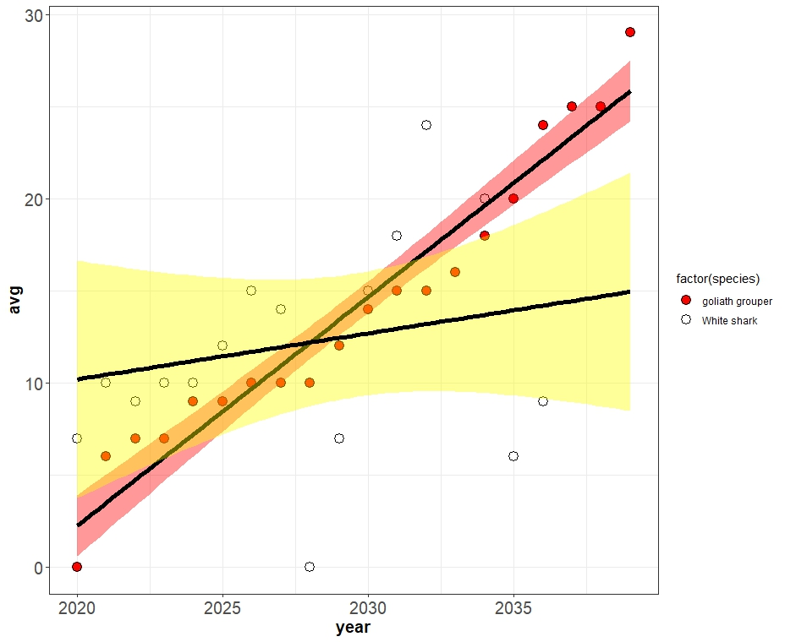
Scatterplots
Notes:
Best:
Outlined points
Colors match
Cis distinct colors
Background white
Color Contrasts ok

Slide 11
Key Points
Identify your GOAL
QUESTION if another figure type / table is better
DESCRIBE your figure in alternative text
Color Contrast
Shapes / Patterns
Backgrounds / Borders
Test it!

Slide 12
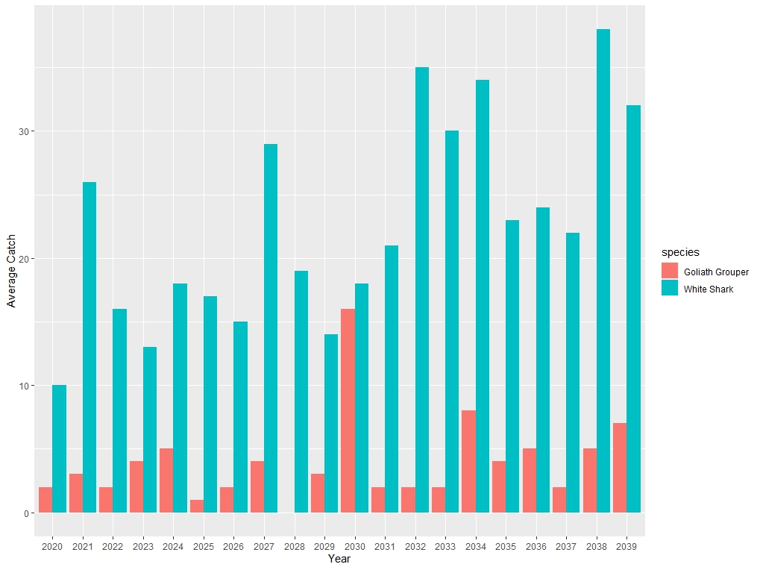
Barplots, Histograms, etc.
Notes:
Not ADA compliant
Uses ONLY color to differentiate!

Slide 13
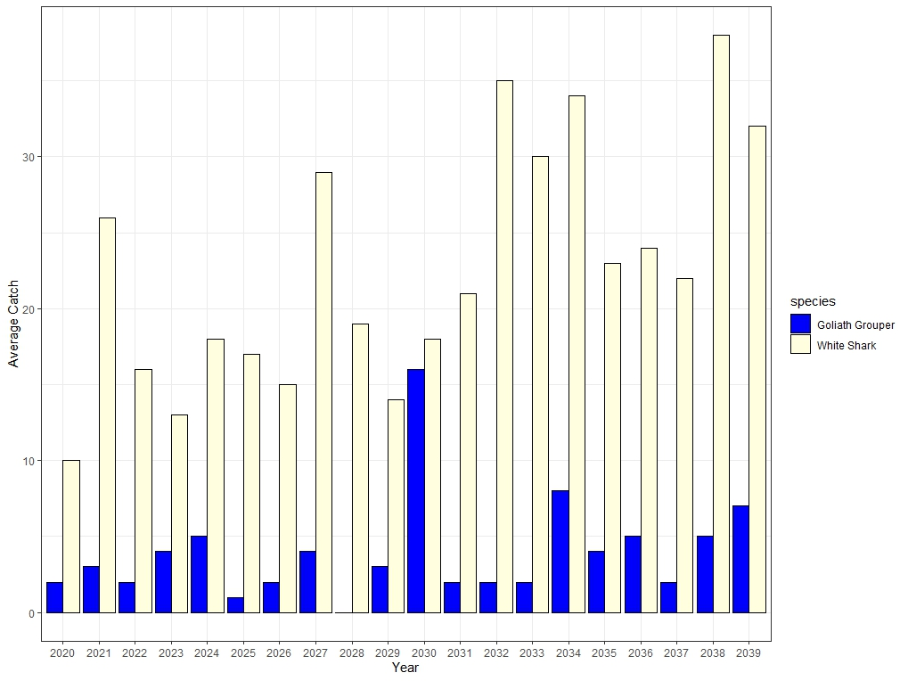
Barplots, Histograms, etc.
Notes:
Background better
Colors contrast
Outline furthers color contrast

Slide 14
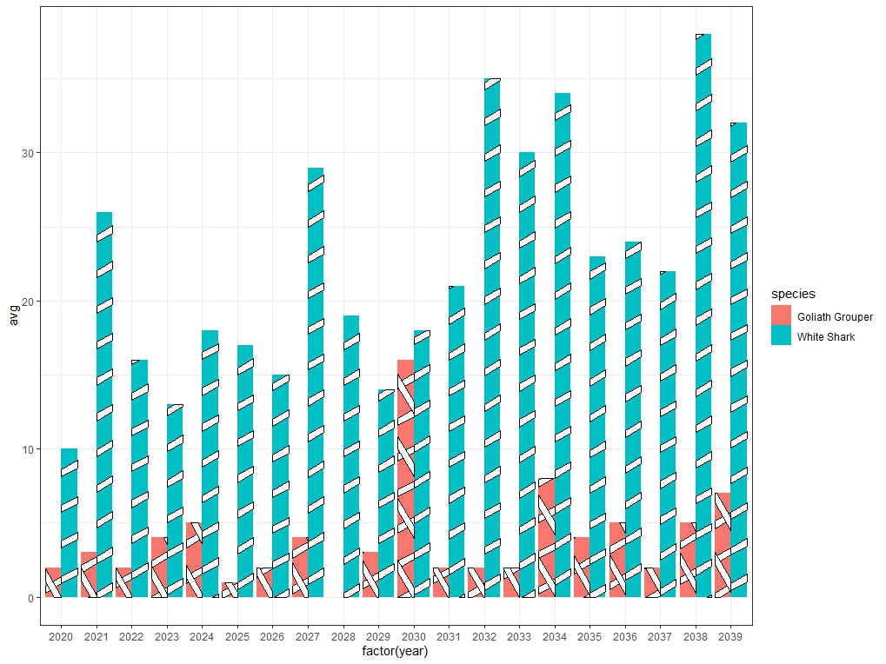
Barplots, Histograms, etc.
Notes:
Pattern fills – friend or enemy?

Slide 15
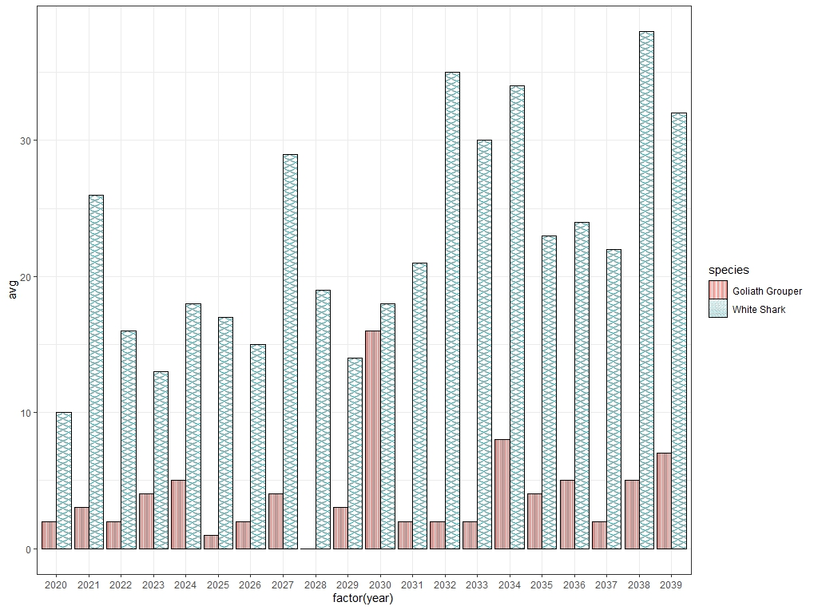
Barplots, Histograms, etc.
Notes:
Outlines help
Direction of pattern helps
But…

Slide 16
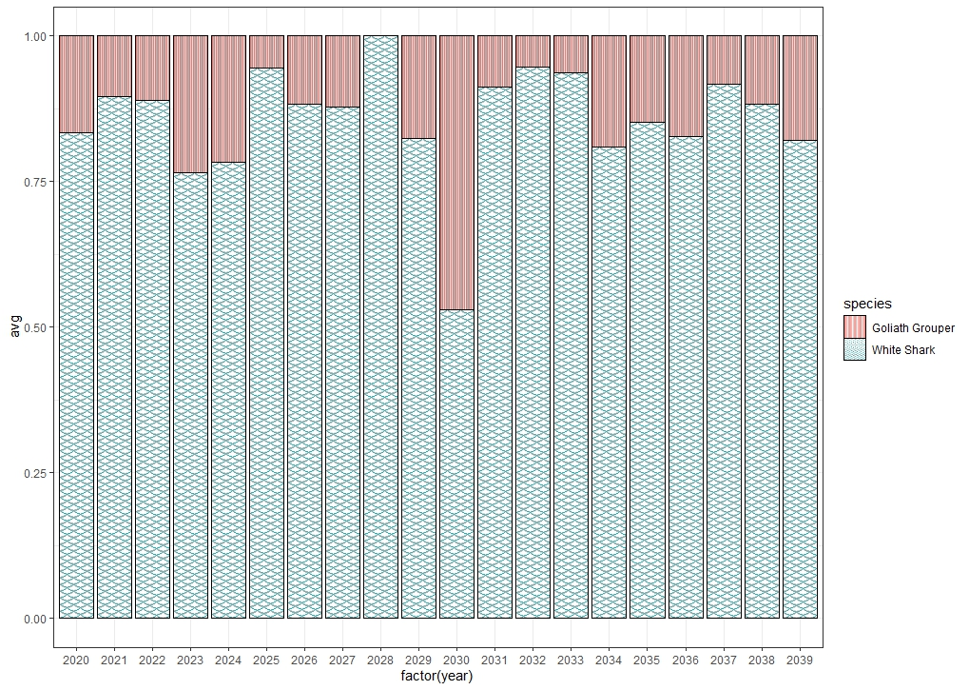
Relative Abundance, Pie Charts
Notes:
Consider other figure type
With few species- easy
But…

Slide 17
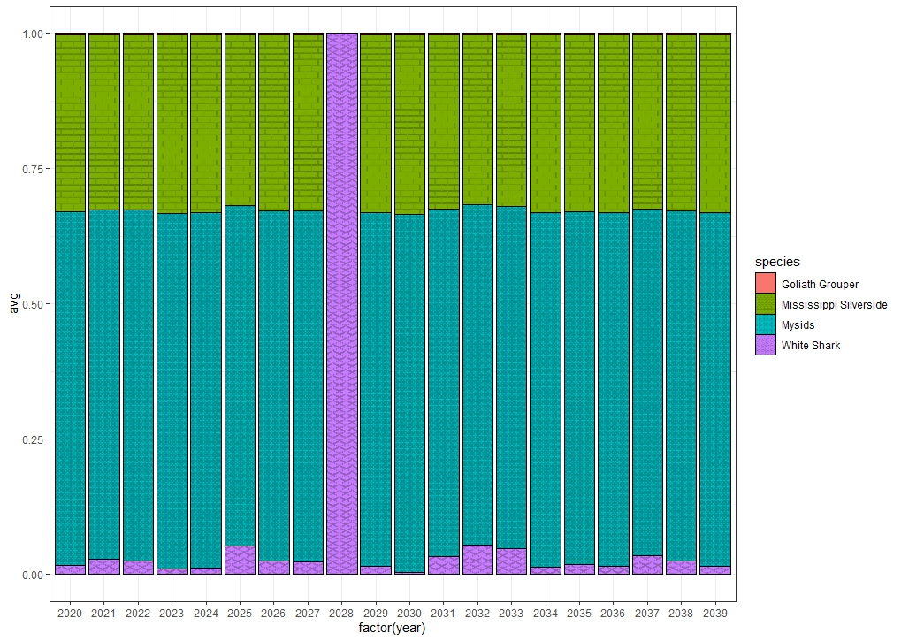
Relative Abundance, Pie Charts
Notes:
Even with borders this is bad
Colors don’t contrast enough
Pattern hard to see when small

Slide 18
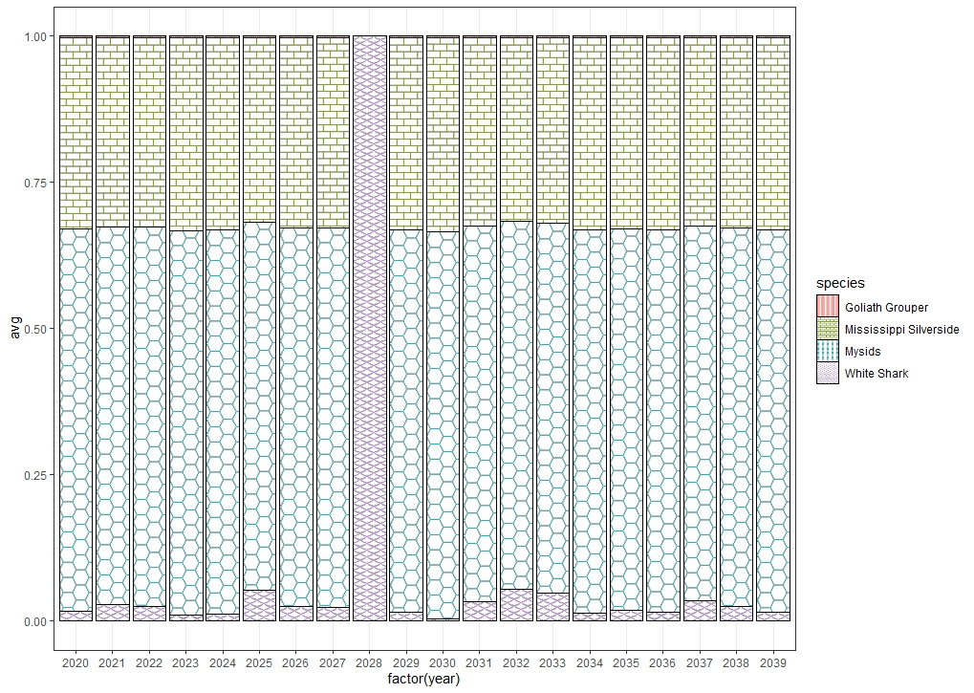
Relative Abundance, Pie Charts
Notes:
Pick better patterns
But you cant know which will go side-by-side!
Maximum limit ~10 colors

Slide 19
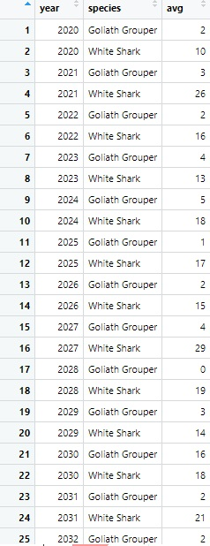
Relative Abundance, Pie Charts
Notes:
Can a table do it better?

Slide 20
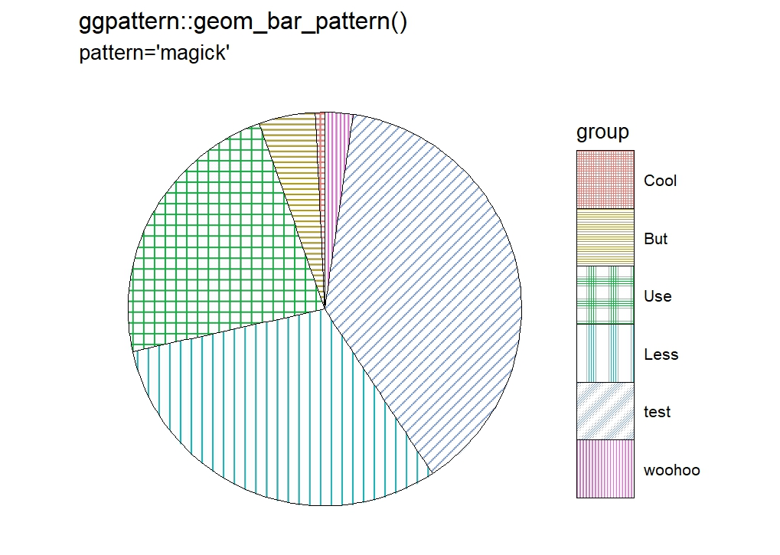
Relative Abundance, Pie Charts

Slide 21
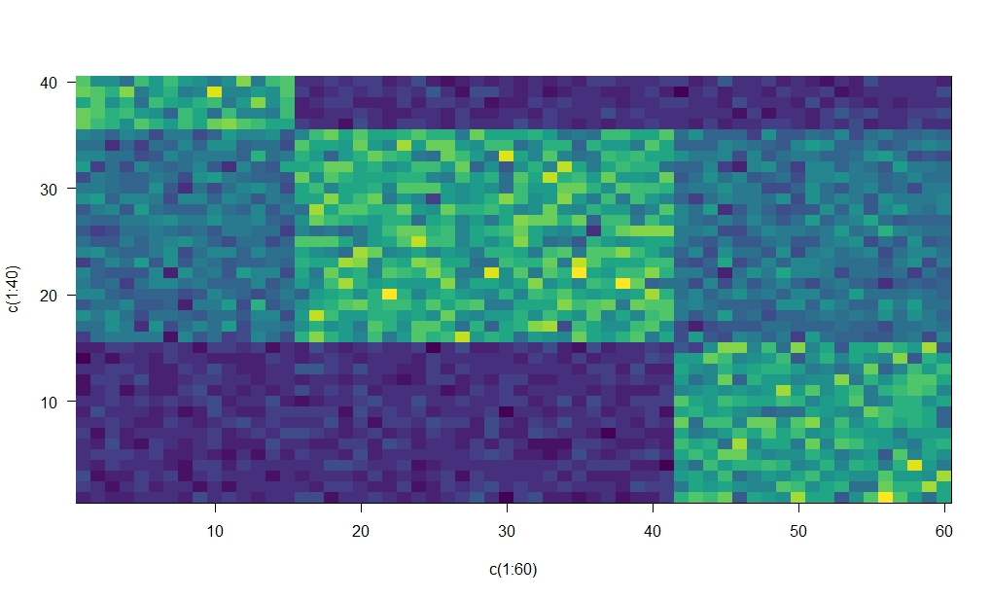
Heat maps / Gradients
Notes:
Up until now I havnt talked about “viridis”
Viridis is….
This figure is viridis but is NOT ADA-compliant

Slide 22
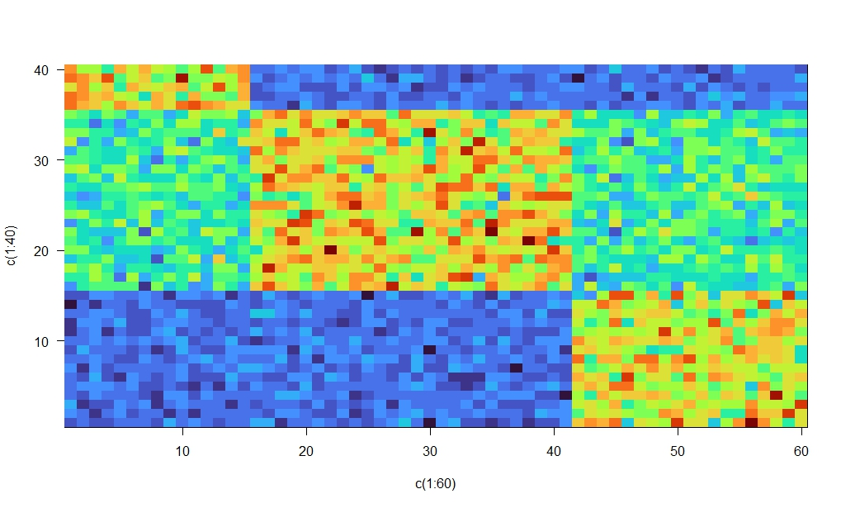
Heat maps / Gradients
Notes:
Turbo is better – works the same

Slide 23
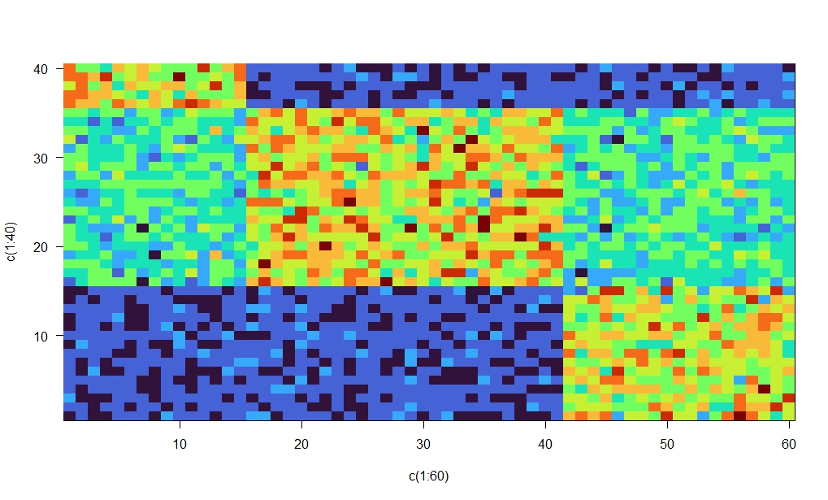
Heat maps / Gradients
Notes:
Law of diminishing returns….
N = 10

Slide 24
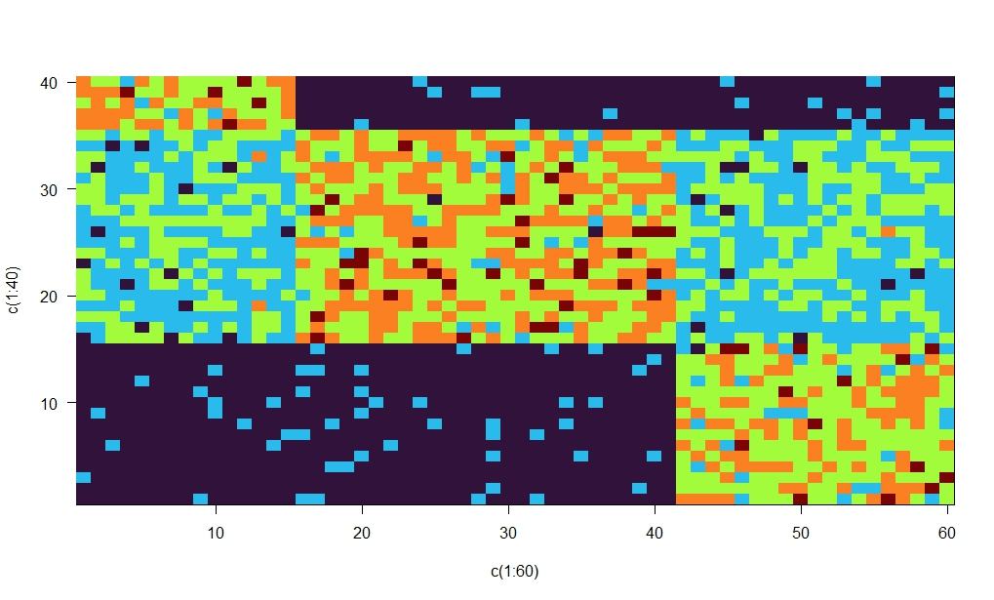
Heat maps / Gradients
Notes:
Law of diminishing returns….
N = 5

Slide 25
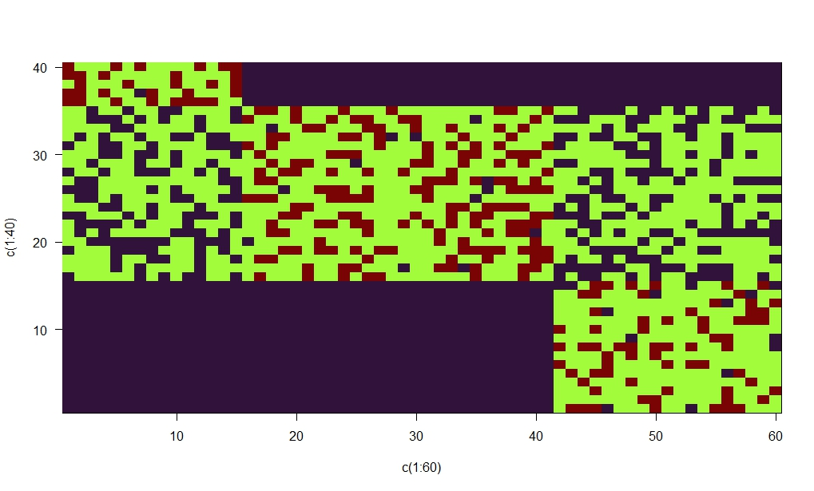
Heat maps / Gradients
Notes:
Law of diminishing returns….
N = 3

Slide 26
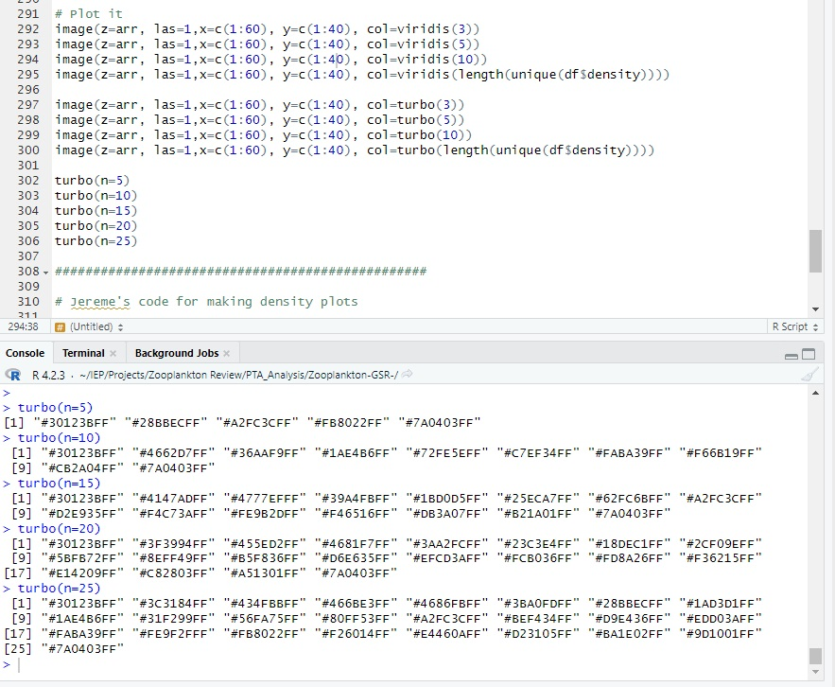
Heat maps / Gradients
Notes:
Viridis + Turbo both:
Get color palettes for exact # colors you need.
Maximizes color contrasts
Doesn’t ensure colors wont be side-by-side
Borders still helpful
Limit color count

Slide 27
Viridis / Turbo
ADA-compliant color palettes…. SOME TIMES
Consider black borders or spacing to augment

Slide 28
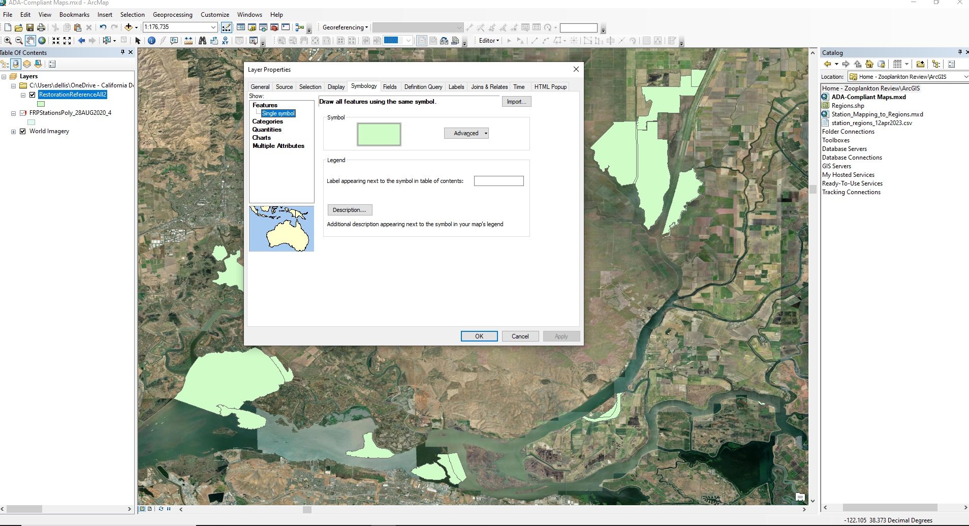
Mapping
Notes:
ArcGIS - Symbology

Slide 29
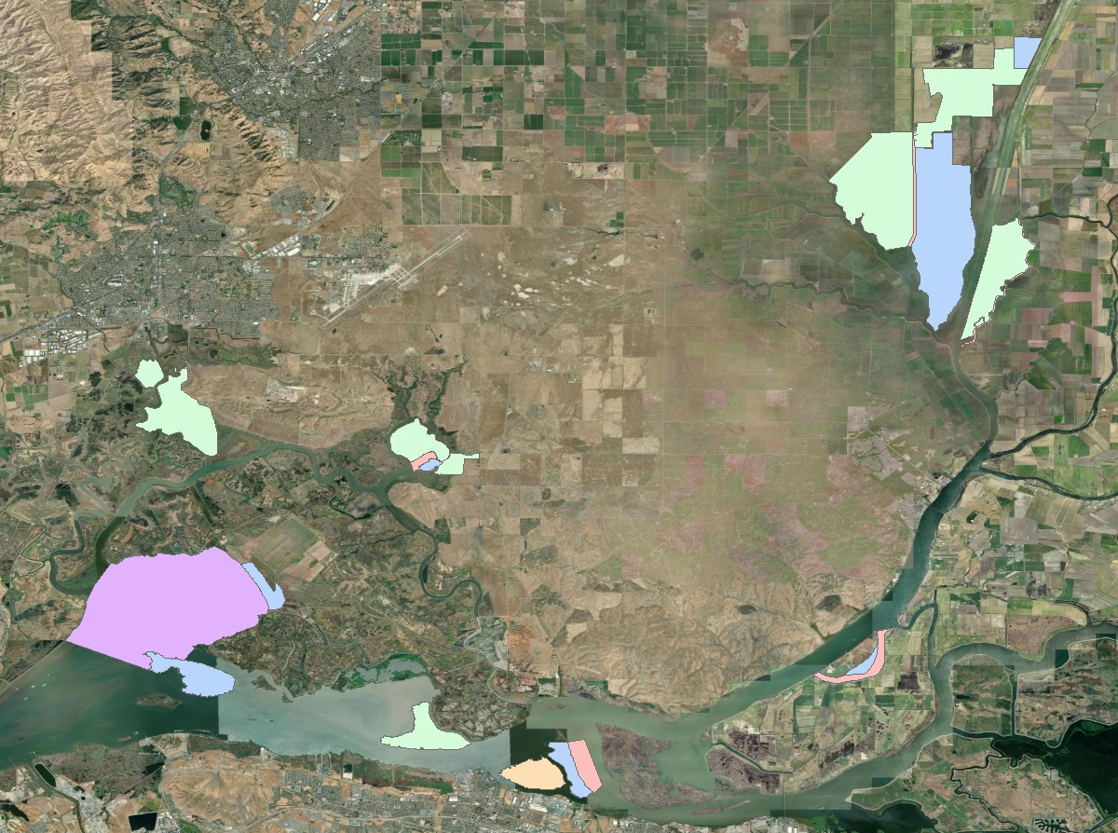
Mapping
Notes:
Colors on base map

Slide 30
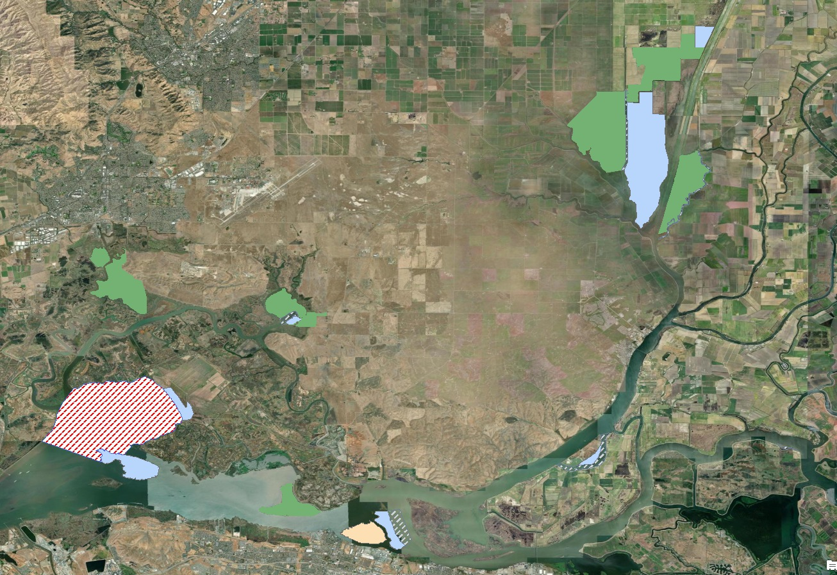
Mapping
Notes:
Add pattern

Slide 31
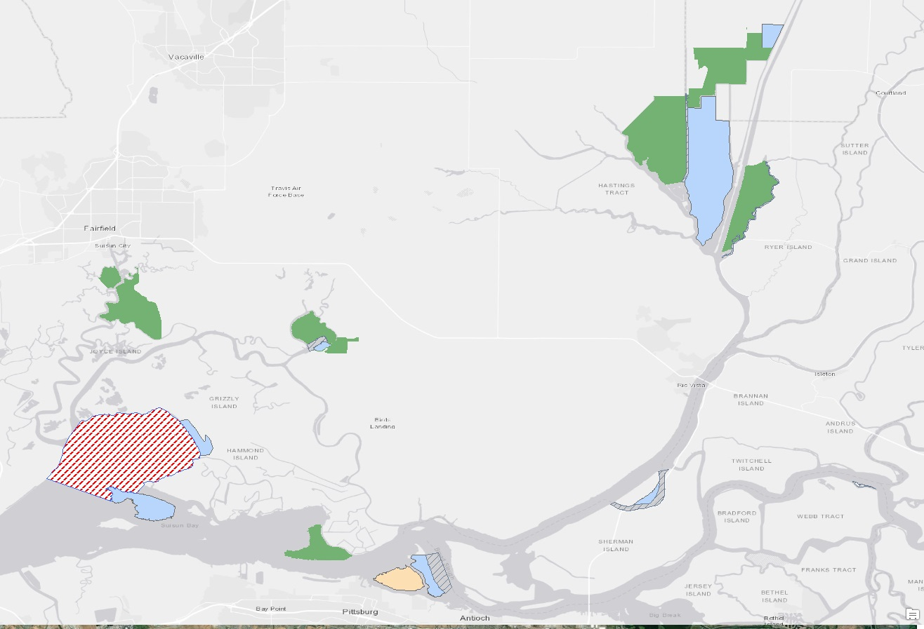
Mapping
Notes:
Change base map

Slide 32
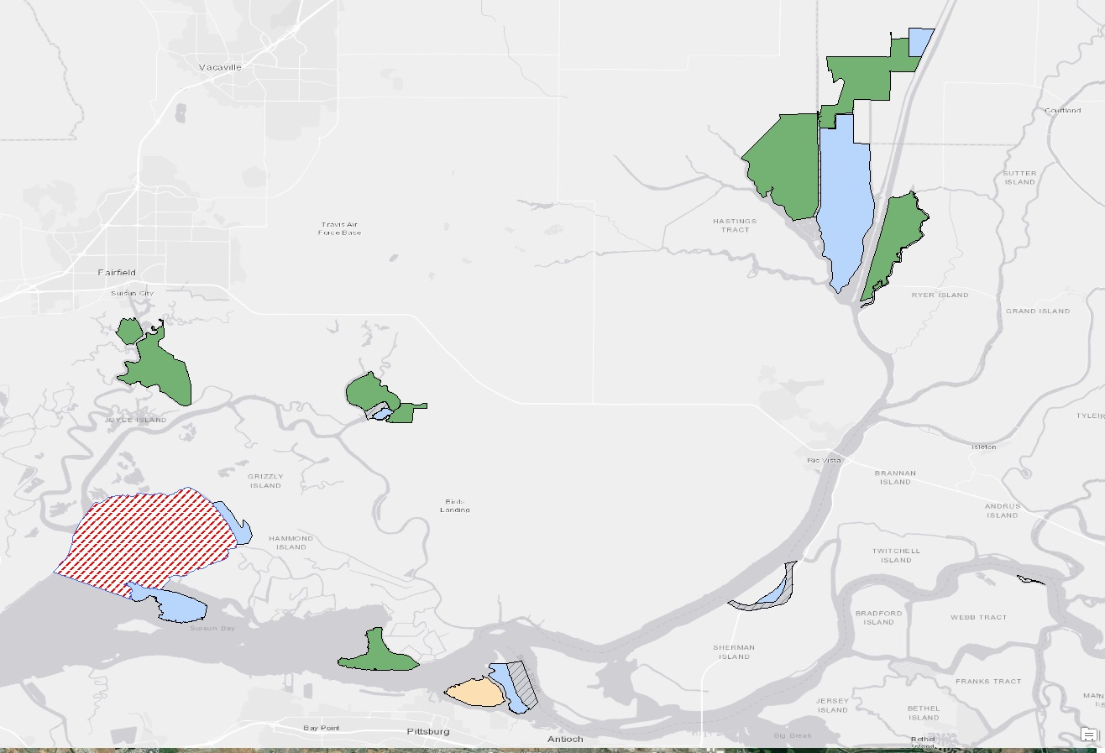
Mapping
Notes:
Add border

Slide 33
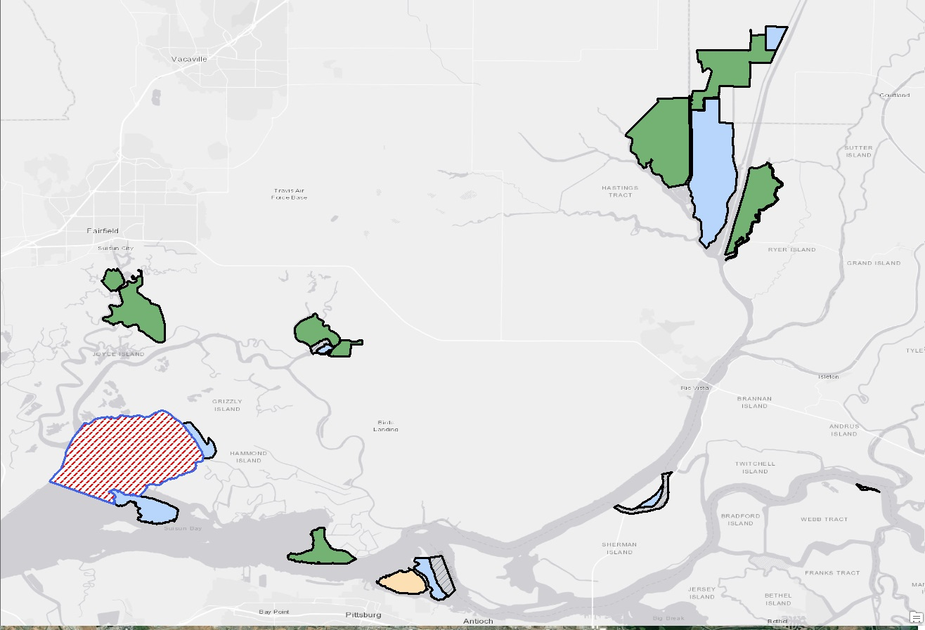
Mapping
Notes:
Thicken border

Slide 34
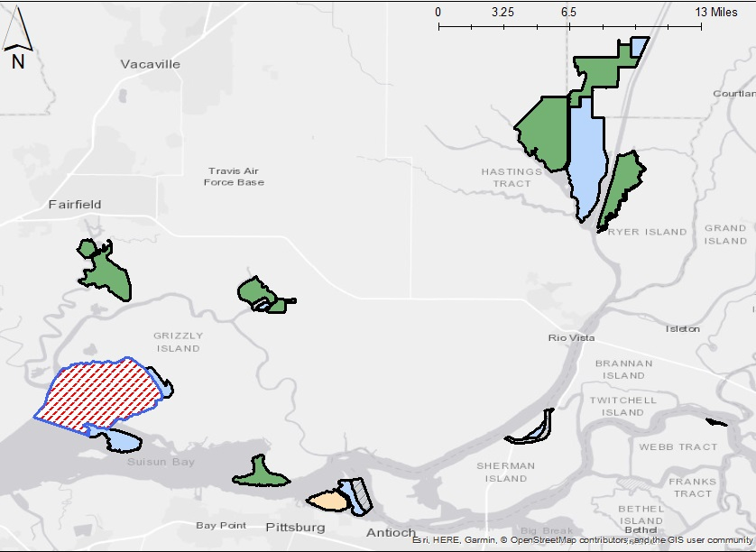
Mapping
Notes:
Add scale bar and N arrow

Slide 35
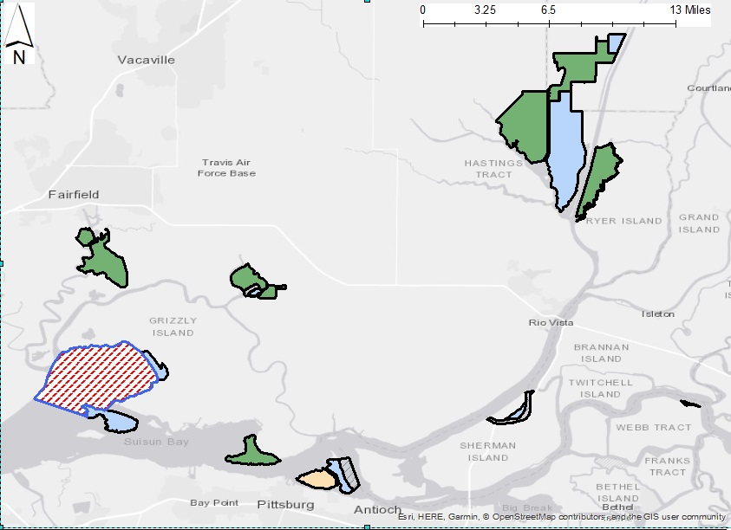
Mapping
Notes:
Add backgrounds to those items

Slide 36
Mapping
Base maps
Outlines
Texture / Pattern
Transparency

Slide 37
Key Points
Identify your GOAL
QUESTION if another figure type / table is better
DESCRIBE your figure in alternative text?
Color Contrast
Shapes / Patterns
Backgrounds / Borders
Test it!

Slide 38
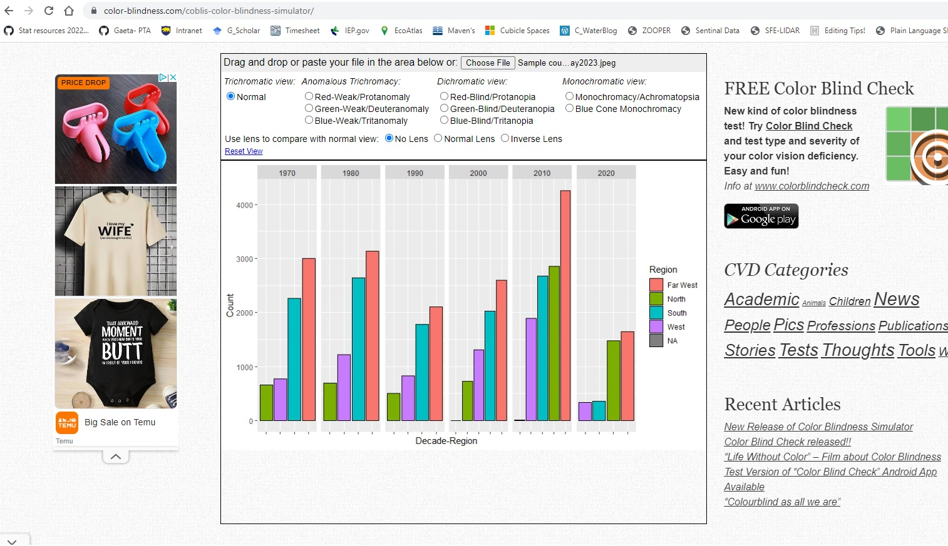
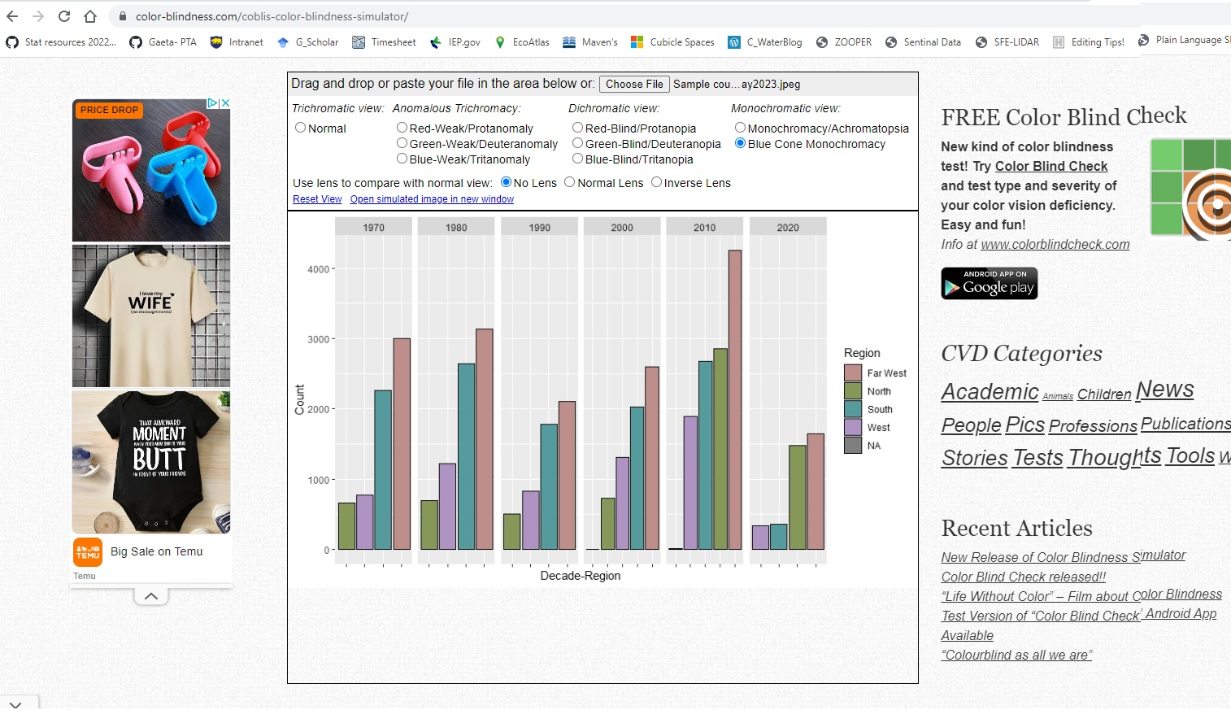
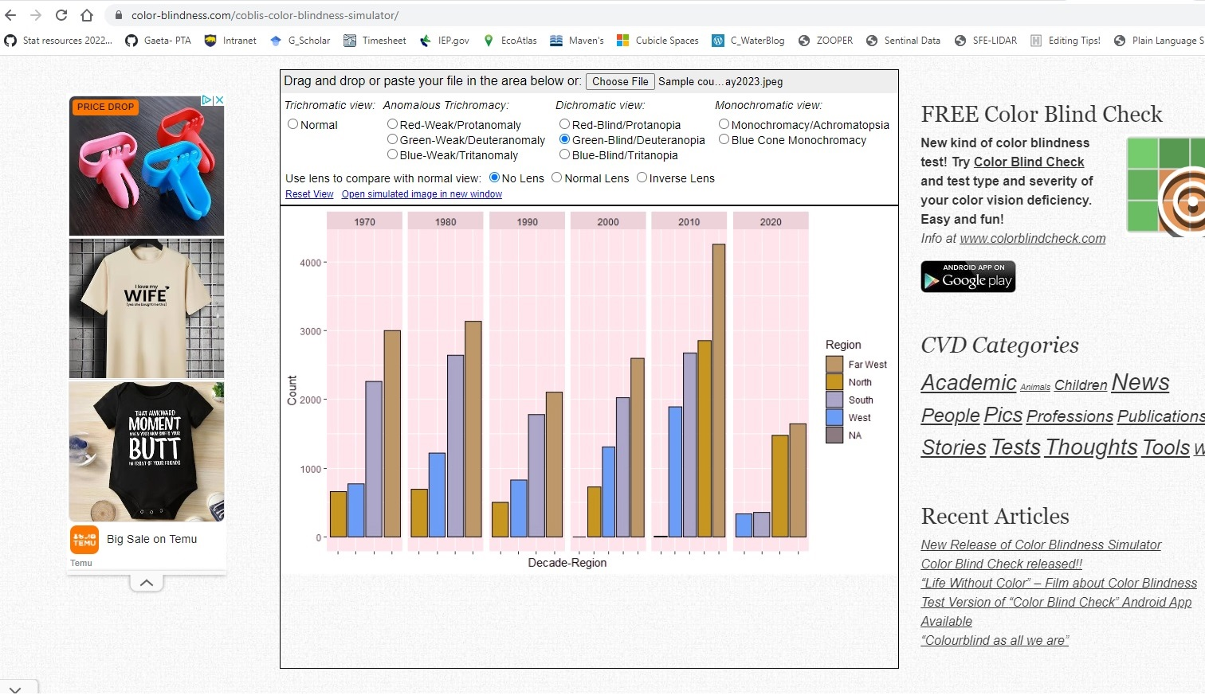
Resources
https://www.color-blindness.com/coblis-color-blindness-simulator/
Notes:
Test your figures!

Slide 39
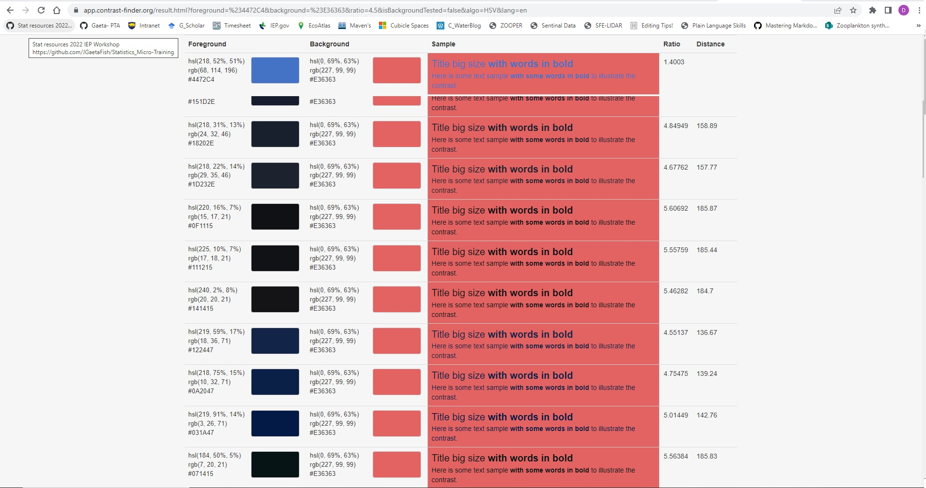
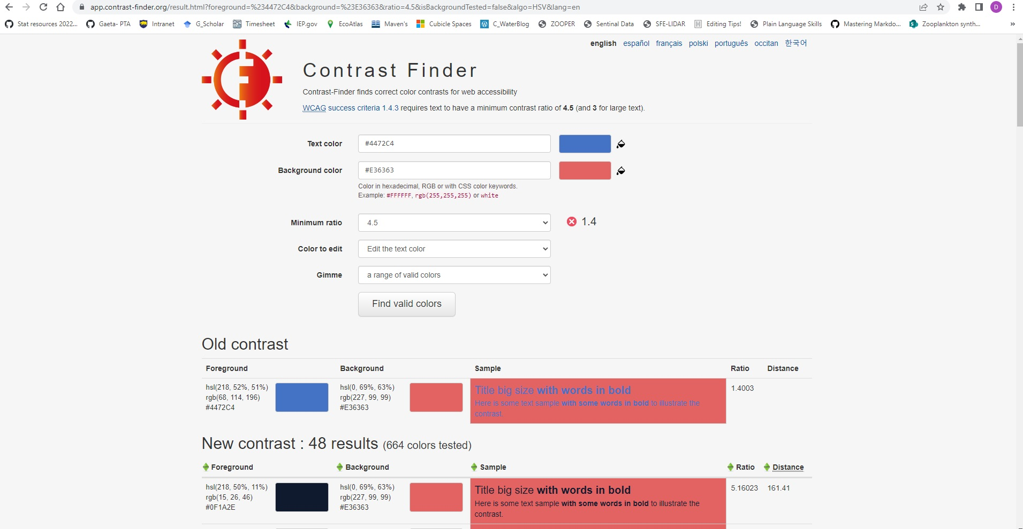
Resources
https://app.contrast-finder.org/result.html?foreground=%23534741&background=Black&ratio=4.5&isBackgroundTested=false&algo=HSV&lang=en
Notes:
Test your figures!

Slide 40
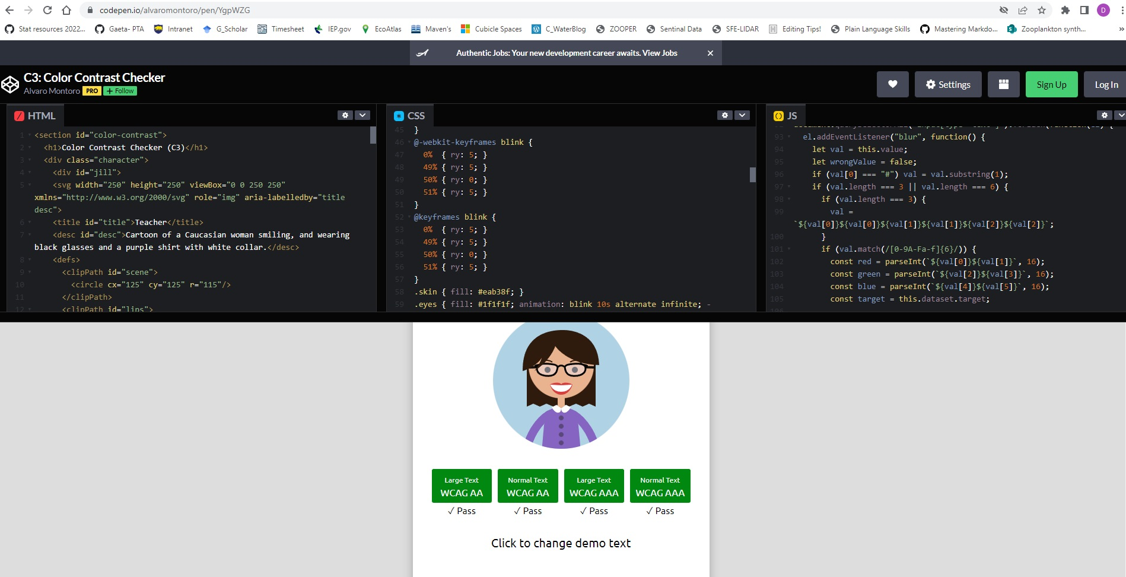
Resources
https://codepen.io/alvaromontoro/pen/YgpWZG
Notes:
Can make your own checker.

Slide 41
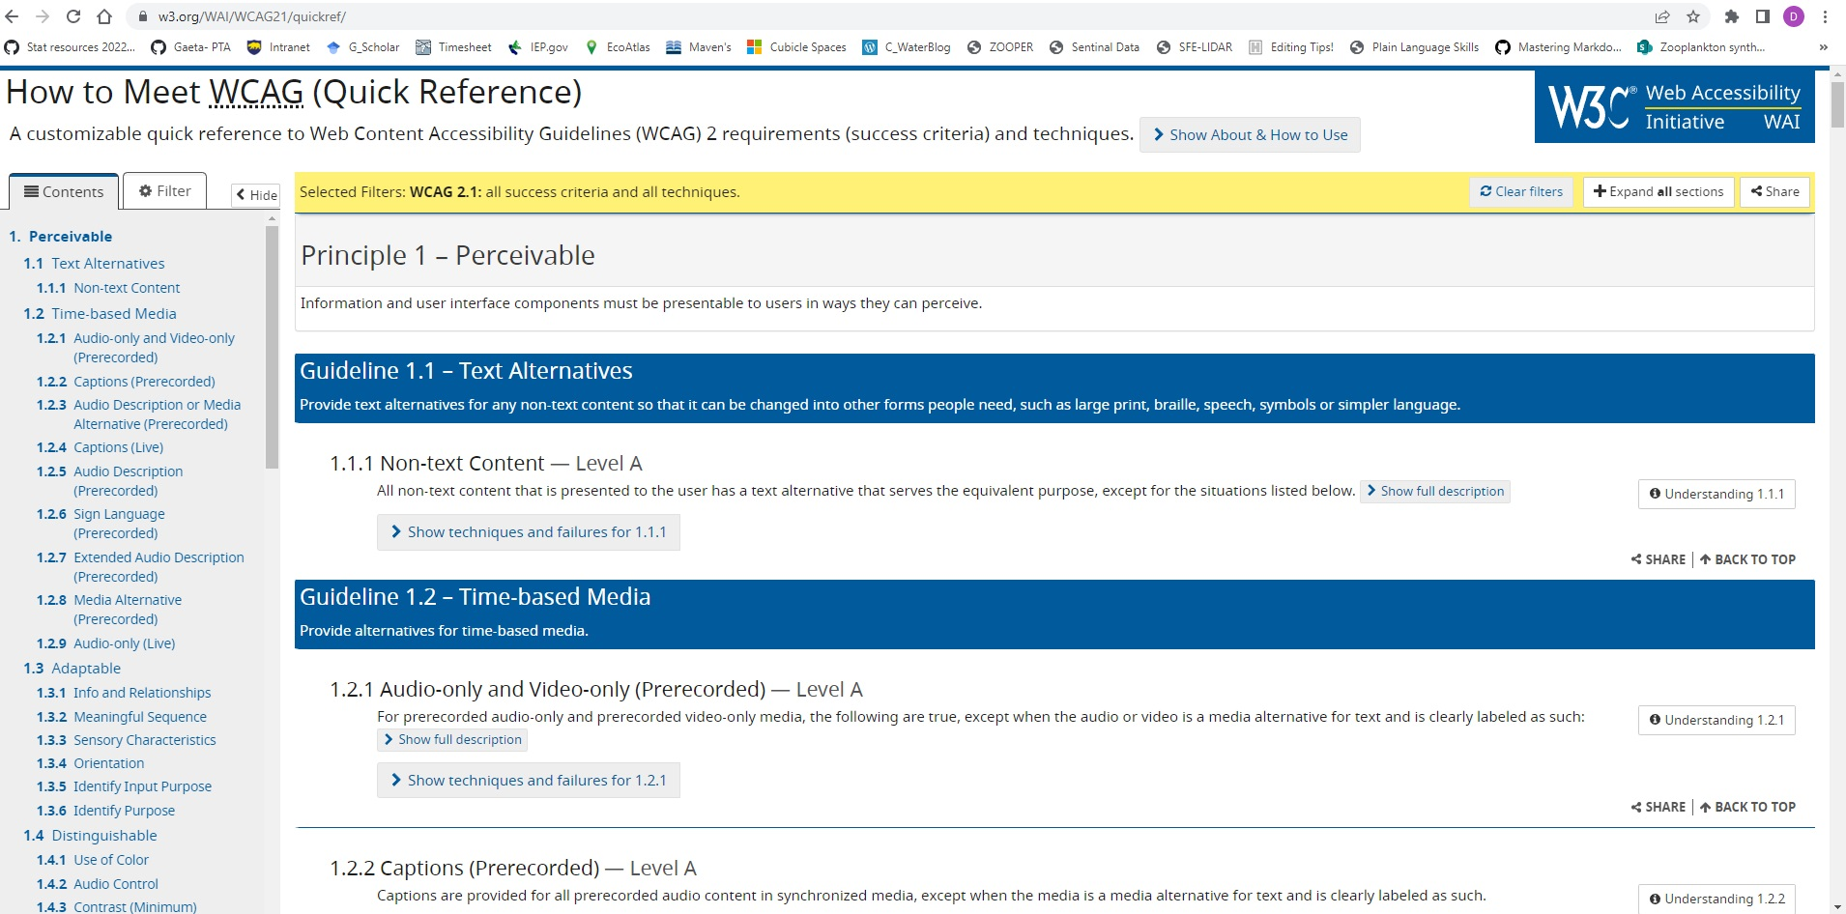
Resources
https://www.w3.org/WAI/standards-guidelines/wcag/
Notes:
Check out the language and ADA requirements later on your own…

Slide 42
Questions?
Daniel Ellis, Daniel.ellis@wildlife.ca.gov

